Slide 1

Modern Testing mit JUnit 5
JUG Ostfalen – 18.10.18
Notes:
Dmitrij Drandarov, arbeite seit mehreren Jahren bei der msg DAVID in Braunschweig, studiere gerade den Master und freue mich diesen Vortrag halten zu dürfen.

Slide 2
Vorab:
Modern Testing mit JUnit 5
Gerne Zwischenfragen stellen!
Sonst: Diskussionen in der Pause / nach dem Vortrag
Gerne Feedback da lassen!

Slide 3
Inhalt
Modern Testing mit JUnit 5
Einleitung
JUnit 5 Hintergrund
Änderungen seit JUnit 4 und Migration
JUnit 5
Basic features
Advanced features
Beispiele für Nutzung der neuen APIs von JUnit 5
(Extra: Best-Practices in JUnit)

Slide 4
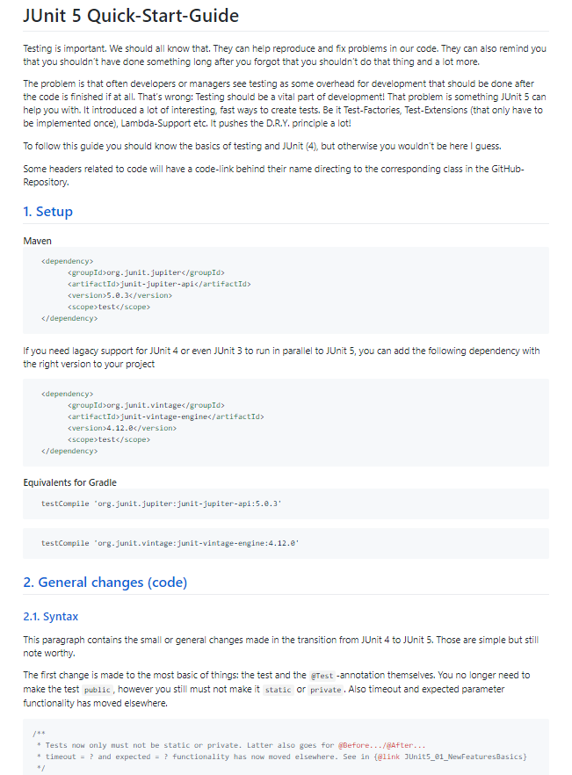

Inhalt
Modern Testing mit JUnit 5
Vortrag
Viel Code!
Alles kann somit online wiedergefunden werden!
Statt Stichpunkten gibts oft JavaDoc

Slide 5
JUnit 5
Modern Testing mit JUnit 5
Release:
October 2016
(JUnit 4 Release: 2006)
Inhatlich
Von Grund auf neu gebaut!
Viel modularisiert!
Viele neue APIs
Aktuelle Version: 5.0.3

Slide 6
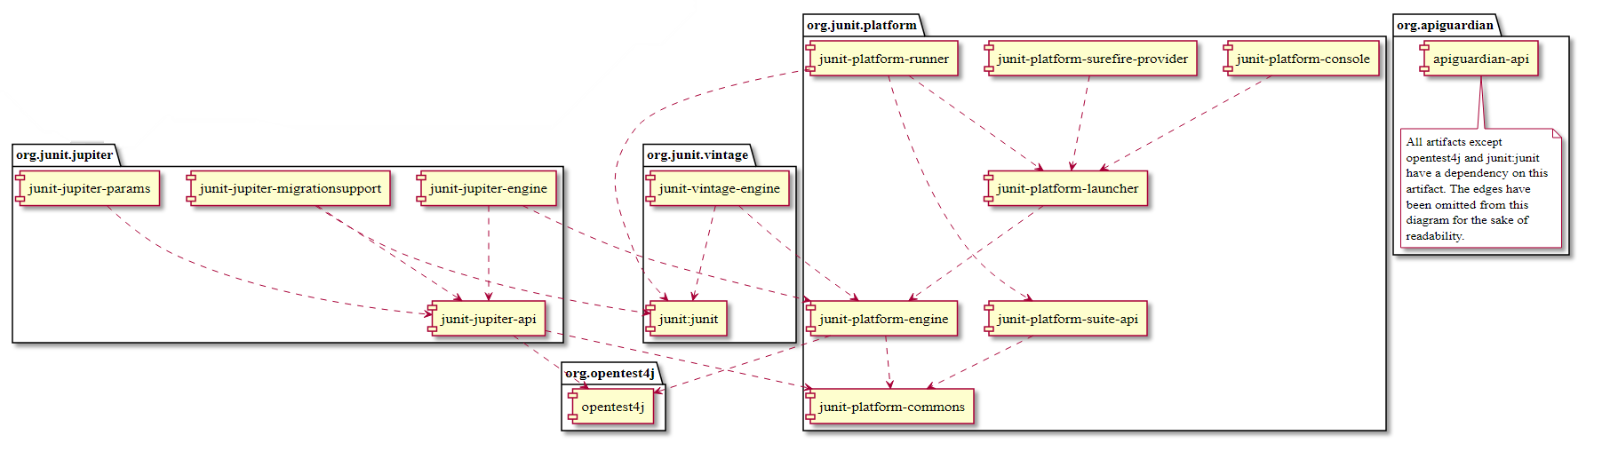
JUnit 5
Modern Testing mit JUnit 5
JUnit Platform
Grundlage für JUnit 5
JUnit Jupiter
Beinhaltet die neuen APIs
JUnit Vintage
Ausführen von JUnit 4 Tests

Slide 7
JUnit 5 Setup
Modern Testing mit JUnit 5
Benötigt Java 8+
Fest integrierter Lambda Support

Slide 8
JUnit 5 Setup
Modern Testing mit JUnit 5
Benötigt Java 8+
Fest integrierter Lambda Support
Gradle
dependencies { // Main-dependency needed for JUnit 5 testCompile "org.junit.jupiter:junit-jupiter-api:$junit5_version" }
dependencies { // Main-dependency needed for JUnit 5 testCompile "org.junit.jupiter:junit-jupiter-api:$junit5_version" }

Slide 9
JUnit 5 Setup
Modern Testing mit JUnit 5
Benötigt Java 8+
Fest integrierter Lambda Support
Maven
<dependency> <groupId>org.junit.jupiter</groupId> <artifactId>junit-jupiter-api</artifactId> <version>5.3.1</version> <scope>test</scope> </dependency>

Slide 10
JUnit 5 Setup
Modern Testing mit JUnit 5
Benötigt Java 8+
Fest integrierter Lambda Support
Weitere Dependecies
// Lagacy support for JUnit 4 testCompile "org.junit.vintage:junit-vintage-engine:$vintage4_ver" // Support for running tests through Gradle / Maven classpath "org.junit.platform:junit-platform-gradle-plugin:$platform_ver"
// Lagacy support for JUnit 4 testCompile "org.junit.vintage:junit-vintage-engine:$vintage4_version“
// Support for running tests through Gradle / Maven
classpath "org.junit.platform:junit-platform-gradle-plugin:$platform_version"

Slide 11



Änderungen gegenüber JUnit 4 und Migration
Modern Testing mit JUnit 5
JUnit 4 vs. JUnit 5

Slide 12
Änderungen gegenüber JUnit 4 und Migration
Modern Testing mit JUnit 5
Man kann JUnit 4 und 5 sogar mixen!
public class JUnit5_00_Mixing_JUnit4_JUnit5 { @org.junit.Test public void junit4Test() { Assert.assertTrue(true); // JUnit 4 Assertion Assertions.assertTrue(true); // JUnit 5 Assertion } @org.junit.jupiter.api.Test void junit5Test() { Assert.assertTrue(true); // JUnit 4 Assertion Assertions.assertTrue(true); // JUnit 5 Assertion } }
public class JUnit5_00_Mixing_JUnit4_JUnit5 { @org.junit.Test public void junit4Test() { Assert.assertTrue(true); // JUnit 4 Assertion Assertions.assertTrue(true); // JUnit 5 Assertion } @org.junit.jupiter.api.Test void junit5Test() { Assert.assertTrue(true); // JUnit 4 Assertion Assertions.assertTrue(true); // JUnit 5 Assertion } }

Slide 13
JUnit 4 vs. JUnit 5
Modern Testing mit JUnit 5
@Test / Test-Methoden
/** * Tests now only must not be static or private. * Latter also goes for @Before.../@After... * timeout = ? and expected = ? functionality has now moved elsewhere. */ @Test void testTest() { // I'm a test! }
/** * Tests now only must not be static or private.
* Latter also goes for @Before.../@After... * timeout = ? and expected = ? functionality has now moved elsewhere. */ @Test void testTest() {
// I’m a test! 👍
}

Slide 14
JUnit 4 vs. JUnit 5
Modern Testing mit JUnit 5
@Before → @BeforeEach / @BeforeClass → @BeforeAll
/** * Annotation @BeforeClass was replaced by @{@link BeforeAll}. * Needs to be static. Same for @AfterClass. */ @BeforeAll static void beforeAll() {} /** * Annotation @Before was replaced by @{@link BeforeEach}. * Same for @After. */ @BeforeEach void beforeEach() {}
/** * Annotation @BeforeClass was replaced by @{@link BeforeAll}.
* Needs to be static. Same for @AfterClass. */ @BeforeAll static void beforeAll() {} /** * Annotation @Before was replaced by @{@link BeforeEach}.
* Same for @After. */ @BeforeEach void beforeEach() {}

Slide 15
JUnit 4 vs. JUnit 5
Modern Testing mit JUnit 5
@Ignored → @Disabled
/** * Annotation @Ignore was replaced by @{@link Disabled}.
* Sounds less negative. * However a reason for the deactivation will be printed which * can be more advanced with features like {@link ExecutionCondition}. */ @Disabled @Test void disabledTest() { }
/** * Annotation @Ignore was replaced by @{@link Disabled}. Sounds less negative. * However a reason for the deactivation will be printed which
* can be more advanced with features like {@link ExecutionCondition}. */ @Disabled @Test void disabledTest() {}

Slide 16
JUnit 4 vs. JUnit 5
Modern Testing mit JUnit 5
@Category → @Tag
/** * JUnit 4s experimental @Category is now called @Tag / @Tags. */ @Tag("abc") @Test void taggedTest() { }
/** * JUnit 4s experimental @Category is now called @Tag/@Tags. */ @Tag("abc") @Test void taggedTest() {}

Slide 17
JUnit 4 vs. JUnit 5
Modern Testing mit JUnit 5
apply plugin: 'org.junit.platform.gradle.plugin' // Gradle-Configuration for JUnit 5 Platform junitPlatform { filters { engines { // include 'junit-jupiter', 'junit-vintage' // exclude 'custom-engine' } tags { // include 'incTag' // exclude 'excTag' } includeClassNamePattern '.*' } enableStandardTestTask true }
@Category → @Tag
/** * JUnit 4s experimental @Category is now called @Tag / @Tags. */ @Tag("abc") @Test void taggedTest() { }
/** * JUnit 4s experimental @Category is now called @Tag/@Tags. */ @Tag("abc") @Test void taggedTest() {}

Slide 18
JUnit 4 vs. JUnit 5
Modern Testing mit JUnit 5
Assert → Assertions
/** * Assertion Methods are now in class {@link Assertions}. */ @Test void assertionsTest() { Assertions.assertTrue(true); // Without static import assertTrue(true); // With static import }

Slide 19
JUnit 4 vs. JUnit 5
Modern Testing mit JUnit 5
Assume → Assumption
/** * Assumption Methods are now in class {@link Assumtions}. */ @Test void assertionsTest() { Assumptions.asumeTrue(true); // Without static import asumeTrue(true); // With static import }
/** * Assumption Methods are now in class {@link Assumptions}. * Fails the test. */ @Test void assumptionsTest() { Assumptions.assumeTrue(true); // Without static import assumeTrue(true); // With static import }

Slide 20

JUnit 5 - Basic features
Modern Testing mit JUnit 5
Basic features

Slide 21
JUnit 5: Display Names
Modern Testing mit JUnit 5
/** * Tests can now receive Display-Names via @DisplayName. * These are e.g. used by the IDE, Console or the TestInfo-Parameter. */ @Test @DisplayName("Choose a display name") void displayNameTest() { }
/** * Tests can now receive Display-Names via @{@link DisplayName}. * These are e.g. used by the IDE, Console or the TestInfo-Parameter
* (addressed in {@link #parameterTest(TestInfo, TestReporter)}). */ @Test @DisplayName("Choose a display name") void displayNameTest() {
}

Slide 22
JUnit 5: Display Names
Modern Testing mit JUnit 5
/** * Tests can now receive Display-Names via @DisplayName. * These are e.g. used by the IDE, Console or the TestInfo-Parameter. */ @Test @DisplayName("Choose a display name") void displayNameTest() { }
/** * Tests can now receive Display-Names via @{@link DisplayName}. * These are e.g. used by the IDE, Console or the TestInfo-Parameter
* (addressed in {@link #parameterTest(TestInfo, TestReporter)}). */ @Test @DisplayName("Choose a display name") void displayNameTest() {
}

Slide 23
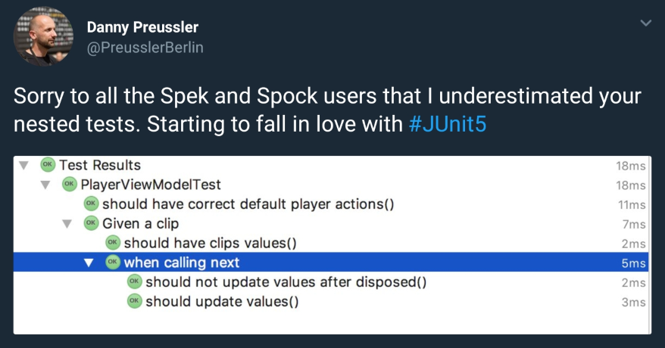
JUnit 5: Display Names → Natural language
Modern Testing mit JUnit 5

Slide 24
JUnit 5: Display Names → Natural language
Modern Testing mit JUnit 5
Mit großer Macht, kommt große Verantwortung…

Slide 25
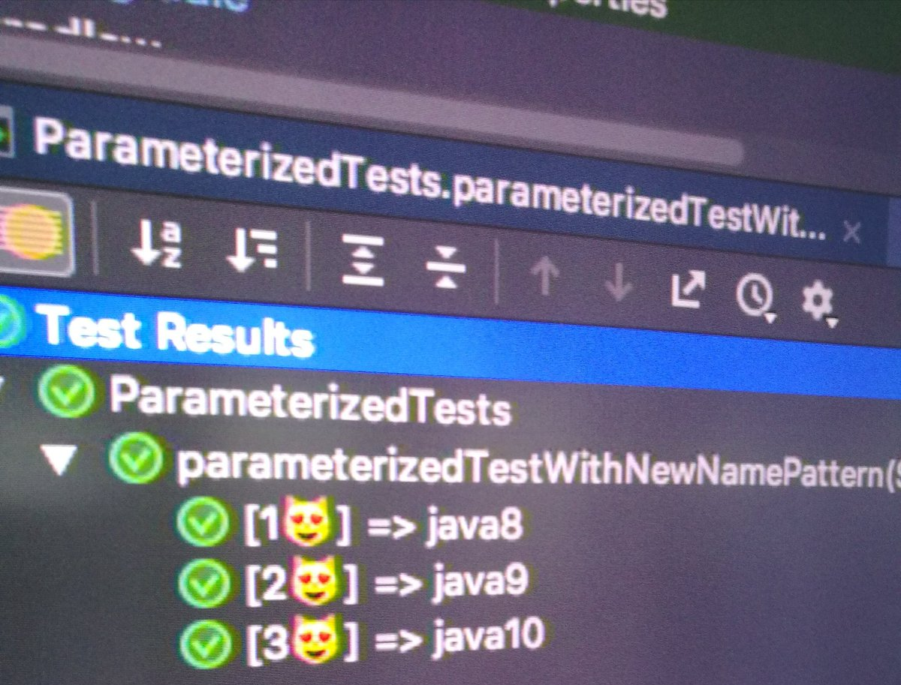
JUnit 5: Display Names → Natural language
Modern Testing mit JUnit 5
Mit großer Macht, kommt große Verantwortung…

Slide 26
JUnit 5: Grouped Tests
Modern Testing mit JUnit 5

Slide 27
JUnit 5: Grouped Tests
Modern Testing mit JUnit 5
@Nested @DisplayName("Executing...") class groupedTests { @Test @DisplayName("Test 1") void groupedTest1() {} @Test @DisplayName("Test 2") void groupedTest2() {} }
@Nested @DisplayName("Executing…") class groupedTests { @Test @DisplayName("Test 1") void groupedTest1() {} @Test @DisplayName("Test 2") void groupedTest2() {} }

Slide 28
JUnit 5: Lambda Support!
Modern Testing mit JUnit 5
/** * JUnit 5 includes several new Functional-Interface. * One of the most important one is called {@link Executable}. * It is used for certain assertions such as assertAll(Executable...) * and assertThrows(Class, Executable). */ @Test void executablesTest() { Executable ex = () -> assertTrue(5 <= 10); Executable ex2 = () -> assertFalse(Boolean.FALSE); assertAll(ex, ex2); }
/** * JUnit 5 includes several new Functional-Interface.
* One of the most important one is called {@link Executable}. * It is used for certain assertions such as Assertions#assertAll(Executable...)
* and {@link Assertions#assertThrows(Class, Executable)}. */ @Test void executablesTest() { Executable ex = () -> assertTrue(5 <= 10); Executable ex2 = () -> assertFalse(Boolean.FALSE); assertAll(ex, ex2); }

Slide 29
JUnit 5: Lambda Support!
Modern Testing mit JUnit 5
/** * The new assertion-methods now support supplier-interfaces. * E.g. a {@link BooleanSupplier} for the assertion and * a {@link Supplier<String>} for the result-message * * to the {@link Assertions#assertTrue(BooleanSupplier, Supplier)}. */ @Test void assertLambdaTest() { // Simple assertTrue() with BooleanSupplier-Lambda-Implement. assertTrue(() -> Boolean.parseBoolean("true")); // Method references are possible as well of course Assertions.assertTrue(true, this.getClass()::getName); }
/** * The new assertion-methods now support supplier-interfaces. * E.g. a {@link BooleanSupplier} for the assertion and
* a {@link Supplier<String>} for the result-message * to the {@link Assertions#assertTrue(BooleanSupplier, Supplier)}. */ @Test void assertLambdaTest() {
// Simple assertTrue() with BooleanSupplier-Lambda-Implement. assertTrue(() -> Boolean.parseBoolean("true"));
// Method references are possible as well of course
Assertions.assertTrue(true, this.getClass()::getName); }

Slide 30
JUnit 5: Lambda Support!
Modern Testing mit JUnit 5
/** * Assertions has a method called assertAll(Executable...) * that enables us to group assertions, as well as reuse them. */ @Test void assertAllTest() { Executable[] executables = { () -> assertTrue(getData() >= -10), () -> assertTrue(getData() <= +15)}; Assertions.assertAll("Random Tests", executables); dataChanges(); Assertions.assertAll("Random Tests Again", executables); }
/** * Assertions has a method called {@link Assertions#assertAll(Executable...)}
* that enables us to group assertions, as well as reuse them. */ @Test void assertAllTest() { Executable[] executables = { () -> assertTrue(getData() >= -10), () -> assertTrue(getData() <= +15)}; Assertions.assertAll("Random Tests", executables); dataChanges(); Assertions.assertAll("Random Tests Again", executables); }

Slide 31
JUnit 5: Expected Throw
Modern Testing mit JUnit 5
/** * The expected parameter of {@link Test} has moved to * {@link Assertions#assertThrows(Class, Executable)}. */ @Test void assertThrowsTest() { assertThrows( ArrayIndexOutOfBoundsException.class, () -> (new String[1])[2] = "I will throw an Exception :)"); }
/** * The expected parameter of {@link Test} has moved to
* {@link Assertions#assertThrows(Class, Executable)}. */ @Test void assertThrowsTest() { assertThrows( ArrayIndexOutOfBoundsException.class, () -> (new String[1])[2] = "I will throw an Exception :)"); }

Slide 32
JUnit 5: Expected Throw
Modern Testing mit JUnit 5
/** * You can also use {@link Assertions#assertThrows(Class, Executable)} * to get the {@link Exception}-Instance if you need it. */ @Test void expectThrowsTest() { ArrayIndexOutOfBoundsException exc = assertThrows( ArrayIndexOutOfBoundsException.class, () -> (new String[1])[2] = "I will throw an Exception :)"); assertEquals(exc.getMessage(), "2"); }
/** * You can also use {@link Assertions#assertThrows(Class, Executable)}
* to get the {@link Exception}-Instance if you need it. */ @Test void expectThrowsTest() { ArrayIndexOutOfBoundsException exc = assertThrows( ArrayIndexOutOfBoundsException.class, () -> (new String[1])[2] = "I will throw an Exception :)"); assertEquals(exc.getMessage(), "2"); }

Slide 33
JUnit 5 - Advanced features
Modern Testing mit JUnit 5
Advanced features

Slide 34
JUnit 5: Extension API
Modern Testing mit JUnit 5
Test-Methoden und –Klassen mit @ExtendsWith(Extension.class) annotieren
Registriert eine Extension
Ersetzen das @Rule-System aus JUnit 4
Hauptsächlich ParameterResolver / ExecutionCondition / „Execution Hooks“

Slide 35
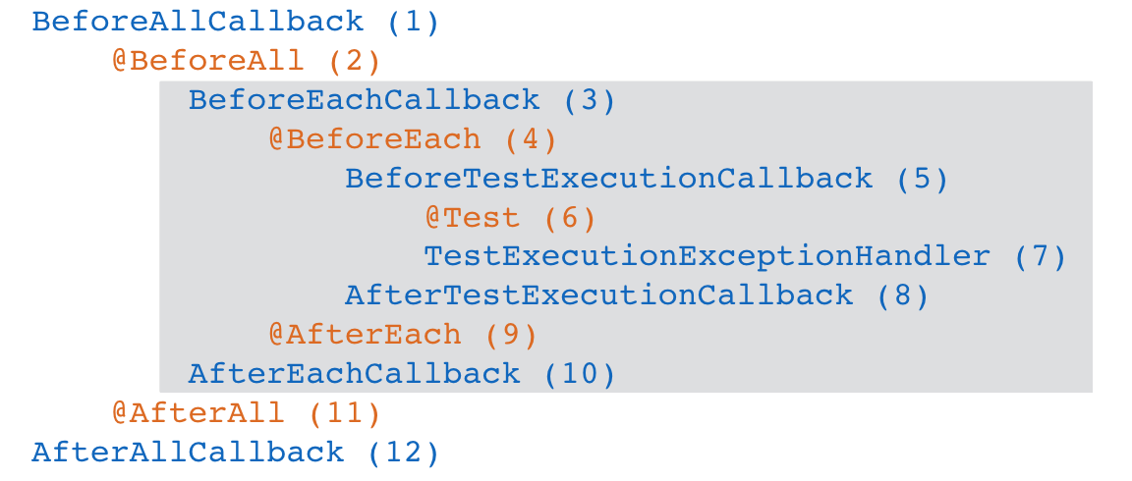
JUnit 5: Extension API
Modern Testing mit JUnit 5
Vordefinierte Execution Hooks

Slide 36
JUnit 5: Advanced Features
Modern Testing mit JUnit 5
Extension: Parameter Resolver

Slide 37
JUnit 5: ParameterResolver
Modern Testing mit JUnit 5
Vordefinierte Parameter Resolver
TestReporter
Injects „method(TestInfo testInfo) { }“
Test-Name, Tags, Class, Method
TestReporter
Injects „method(TestReporter testReporter { }“
Veröffentliche von Test-Reports

Slide 38
JUnit 5: Parameter Resolver
Modern Testing mit JUnit 5
/** * Parameters can be resolved by ParameterResolver-Implementations which in turn * are {link Extension}. * This enables dependency injection at method level. * Resolvers for TestInfo and TestReporter are automatically provided. */ @Test void parameterTest(TestInfo testInfo, TestReporter testReporter) { testReporter.publishEntry("parameterTestTime", String.valueOf(System.currentTimeMillis())); LOG.info("DisplayName:\t" + testInfo.getDisplayName()); LOG.info("Tags:\t\t\t" + testInfo.getTags()); LOG.info("TestClass:\t\t" + testInfo.getTestClass()); LOG.info("TestMethod:\t\t" + testInfo.getTestMethod()); }
/** * Parameters can be resolved by ParameterResolver-Implementations which in turn
* are {link Extension}. * This enables dependency injection at method level. * * Resolvers for TestInfo and TestReporter are automatically provided. */ @Test void parameterTest(TestInfo testInfo, TestReporter testReporter) { testReporter.publishEntry("parameterTestTime",
String.valueOf(System.currentTimeMillis())); LOG.info("DisplayName:\t" + testInfo.getDisplayName()); LOG.info("Tags:\t\t\t" + testInfo.getTags()); LOG.info("TestClass:\t\t" + testInfo.getTestClass()); LOG.info("TestMethod:\t\t" + testInfo.getTestMethod()); }

Slide 39
JUnit 5: Parameter Resolver
Modern Testing mit JUnit 5
/** * These could alternatively be placed at class level. */ @Test @ExtendWith({ClassName_ParameterReslvr.class, ParameterIndex_ParameterReslvr.class}) void customParameterTest(String className, Long parameterIndex) { // Surrounding class name injected by ClassName_ParameterResolver LOG.info(className); // Parameter-Index injected by ParameterIndex_ParameterResolver LOG.info(String.valueOf(parameterIndex)); }
/** * These could alternatively be placed at class level. */ @Test @ExtendWith({ClassName_ParameterReslvr.class, ParameterIndex_ParameterReslvr.class}) void customParameterTest(String className, Long parameterIndex) {
// Surrounding class name injected by ClassName_ParameterResolver LOG.info(className);
// Parameter-Index injected by ParameterIndex_ParameterResolver LOG.info(String.valueOf(parameterIndex));
}

Slide 40
JUnit 5: ClassName_ParameterReslvr.class
Modern Testing mit JUnit 5
public class ClassName_ParameterResolver implements ParameterResolver { /** Checks if the Parameter-Type is a {@link String}. */ @Override public boolean supportsParameter(ParameterContext parameterContext,
ExtensionContext extensionContext){ return parameterContext.getParameter().getType().equals(String.class); } /** Resolves the Parameter by returning the Class-Name */ @Override public Object resolveParameter(ParameterContext parameterContext,
ExtensionContext extensionContext){ Class<?> contextClass = extensionContext.getTestClass().orElse(null); return contextClass == null ? null : contextClass.getSimpleName(); } }

Slide 41
JUnit 5: ParameterIndex_ParameterReslvr.class
Modern Testing mit JUnit 5
public class ParameterIndex_ParameterResolver implements ParameterResolver { /** Checks if the Parameter-Type is a {@link Long}. */ @Override public boolean supportsParameter(ParameterContext parameterContext, ExtensionContext extensionContext) throws ParameterResolutionException { return parameterContext.getParameter().getType().equals(Long.class); } /** Returns the parameterIndex based on the Parameter-Context. */ @Override public Object resolveParameter(ParameterContext parameterContext, ExtensionContext extensionContext) { return (long) parameterContext.getIndex(); } }

Slide 42
JUnit 5: Advanced Features
Modern Testing mit JUnit 5
Dynamic Tests / Test Factories

Slide 43
JUnit 5: Dynamic Tests / Test Factories
Modern Testing mit JUnit 5
/** * Factorize multiple Tests * * Similar to a for-loop that reads data and asserts.
* Tests will be grouped and displayed separately. */ @TestFactory Stream<DynamicTest> testStreamFactoryTest() { Iterator<String> testData = Arrays.asList(new String[]{"1", "2", "3"}).iterator(); return DynamicTest.stream( testData, // Input-Data for the Factory s -> "Displayname: S" + s, // Creating DisplayNames Assertions::assertNotNull); // Providing an Executable }
/** * Factorize multiple Tests * * Similar to a for-loop that reads data and asserts. * Tests will be grouped and displayed seperately. */ @TestFactory Stream<DynamicTest> testStreamFactoryTest() { Iterator<String> testData = Arrays.asList(new String[]{"1", "2", "3"}).iterator(); return DynamicTest.stream( testData, // Input-Data for the Factory s -> "Displayname: S" + s, // Creating DisplayNames Assertions::assertNotNull); // Providing an Executable }

Slide 44
JUnit 5: Advanced Features
Modern Testing mit JUnit 5
Dynamic Tests / Test Factories

Slide 45
JUnit 5: ExecutionCondition
Modern Testing mit JUnit 5
Mondays suck?

Slide 46
JUnit 5: DisabledOnMonday
Modern Testing mit JUnit 5
/** * Use Implementation of ExecutionCondition called DisabledOnMonday to * tell JUnit to disable this test on mondays, because who likes those, right? */ @Test @ExtendWith(DisabledOnMonday.class) void disabledOnMondayTest() { }

Slide 47
JUnit 5: DisabledOnMonday
Modern Testing mit JUnit 5
public class DisabledOnMonday implements ExecutionCondition { @Override public ConditionEvaluationResult evaluateExecutionCondition(ExtensionContext context) { boolean monday = Calendar.getInstance().get(Calendar.DAY_OF_WEEK) == Calendar.MONDAY; return monday ? ConditionEvaluationResult.disabled("I spare you on Mondays.") : ConditionEvaluationResult.enabled(„No spare on other days though >:("); } }

Slide 48
JUnit 5: Examples
Modern Testing mit JUnit 5
Examples

Slide 49
JUnit 5: DisabledOnWeekday
Modern Testing mit JUnit 5
@Test @DisabledWeekdays({Calendar.THURSDAY, Calendar.SATURDAY}) @ExtendWith(DisabledOnWeekday.class) void disabledOnWeekdaysTest() { }

Slide 50
JUnit 5: DisabledOnWeekday
Modern Testing mit JUnit 5
@Test @DisabledWeekdays({Calendar.THURSDAY, Calendar.SATURDAY}) @ExtendWith(DisabledOnWeekday.class) void disabledOnWeekdaysTest() { }
@Retention(RetentionPolicy.RUNTIME) public @interface DisabledWeekdays { int[] value(); }

Slide 51
JUnit 5: DisabledOnWeekday
Modern Testing mit JUnit 5
class DisabledOnWeekday implements ExecutionCondition { ... evaluateExecutionCondition(ExtensionContext context) { // Determine whether the test should be disabled boolean weekdayToday = IntStream.of(weekdayAnnotation.value()) .anyMatch(day -> day == Calendar.getInstance()
.get(Calendar.DAY_OF_WEEK)); // Return a ConditionEvaluationResult based on the weekday return weekdayToday ? ConditionEvaluationResult.disabled("I spare you today.") : ConditionEvaluationResult.enabled("No spare on other days though >:("); } }
DisabledWeekdays weekdayAnnotation =
annotatedElement.getAnnotation(DisabledWeekdays.class); // Determine whether the test should be disabled boolean weekdayToday = IntStream.of(weekdayAnnotation.value()) .anyMatch(day -> day == Calendar.getInstance().get(Calendar.DAY_OF_WEEK)); // Return a ConditionEvaluationResult based on the outcome of the boolean weekdayToday return weekdayToday ? ConditionEvaluationResult.disabled("I spare you today.") : ConditionEvaluationResult.enabled("Don't spare you on other days though >:(");

Slide 52
JUnit 5: Examples
Modern Testing mit JUnit 5
UITest Example

Slide 53
JUnit 5: UITest
Modern Testing mit JUnit 5
@UITest("/fxml/sample.fxml") void userInterfaceTest(Pane root) { LOG.info(String.valueOf(root.getPrefWidth())); // 555.0 (defined in FXML-File) LOG.info(String.valueOf(root.getPrefHeight())); // 333.0 (defined in FXML-File) }

Slide 54
JUnit 5: UITest
Modern Testing mit JUnit 5
@UITest("/fxml/sample.fxml") void userInterfaceTest(Pane root) { LOG.info(String.valueOf(root.getPrefWidth())); // 555.0 (defined in FXML-File) LOG.info(String.valueOf(root.getPrefHeight())); // 333.0 (defined in FXML-File) }
@Test @Tag("userInterface") // Udentification by ParameterResolvers @ExtendWith(PrintUITestData.class) // Prints UI Test Data before each test @ExtendWith(RootElementResolver.class) // Resolves the root pane @Target(ElementType.METHOD) public @interface UITest { String value(); }

Slide 55
JUnit 5: PrintUITestData
Modern Testing mit JUnit 5
class PrintUITestData implements BeforeEachCallback { @Override public void beforeEach(ExtensionContext context) throws Exception { Optional<AnnotatedElement> contextElement = context.getElement(); AnnotatedElement annotatedElement = contextElement.orElse(null); if (annotatedElement != null) { UITest uiTest = annotatedElement.getAnnotation(UITest.class); LOG.info("Doing some setup for " + uiTest.value()); } } }

Slide 56
JUnit 5: RootElementResolver
Modern Testing mit JUnit 5
class RootElementResolver implements ParameterResolver { ... @Override public Object resolveParameter(ParameterContext parameterContext, ExtensionContext extensionContext) { ... UITest annotation = annotatedElement.getAnnotation(UITest.class); FXMLLoader loader = new FXMLLoader(getClass().getResource(annotation.value())); ... return loader.load(); } }
@Override public Object resolveParameter(ParameterContext parameterContext,
ExtensionContext extensionContext) {
... UITest annotation = annotatedElement.getAnnotation(UITest.class); FXMLLoader loader = new FXMLLoader(getClass().getResource(annotation.value())); ...
return loader.load(); }

Slide 57
JUnit 5: Examples
Modern Testing mit JUnit 5
Benchmarks

Slide 58
JUnit 5: @Benchmarked
Modern Testing mit JUnit 5
@Test @Benchmarked void benchmarkedTest() { LOG.info("Calculating some primes..."); int primeCount = 200000; assertEquals(primeCount, IntStream.iterate(2, i -> i + 1) .filter(i -> LongStream .rangeClosed(2, (long) (Math.sqrt(i))).allMatch(n -> i % n != 0)) .limit(primeCount).toArray().length); }

Slide 59
JUnit 5: BenchmarkExtension
Modern Testing mit JUnit 5
... implements BeforeAllCallback, BeforeTestExecutionCallback, AfterTestExecutionCallback, AfterAllCallback { @Override void beforeAll(ExtensionContext context) throws Exception { LOG.info("#### Summary \t" + ... LOG.info("#### Start of Benchmark\t" + ... } @Override void beforeTestExecution(ExtensionContext context) throws Exception { LOG.info("#### Method-Benchm. ####" + ... } @Override void afterTestExecution(ExtensionContext context) throws Exception { LOG.info("#### Start ####" + ... LOG.info("#### End ####" + ... LOG.info("#### Duration ####" + ... } @Override void afterAll(ExtensionContext context) throws Exception { LOG.info("#### Duration for class\t" + ... + " ms ####"); } }

Slide 60
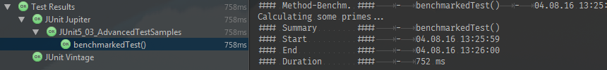
JUnit 5: @Benchmarked
Modern Testing mit JUnit 5
Benchmarks

Slide 61
JUnit 5: Best Practice
Modern Testing mit JUnit 5
Real world use cases

Slide 62
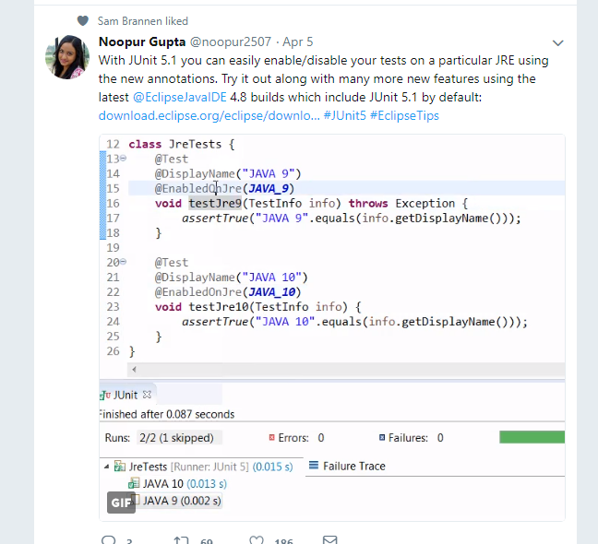
JUnit 5: Testen von verschiedenen JDKs
Modern Testing mit JUnit 5

Slide 63
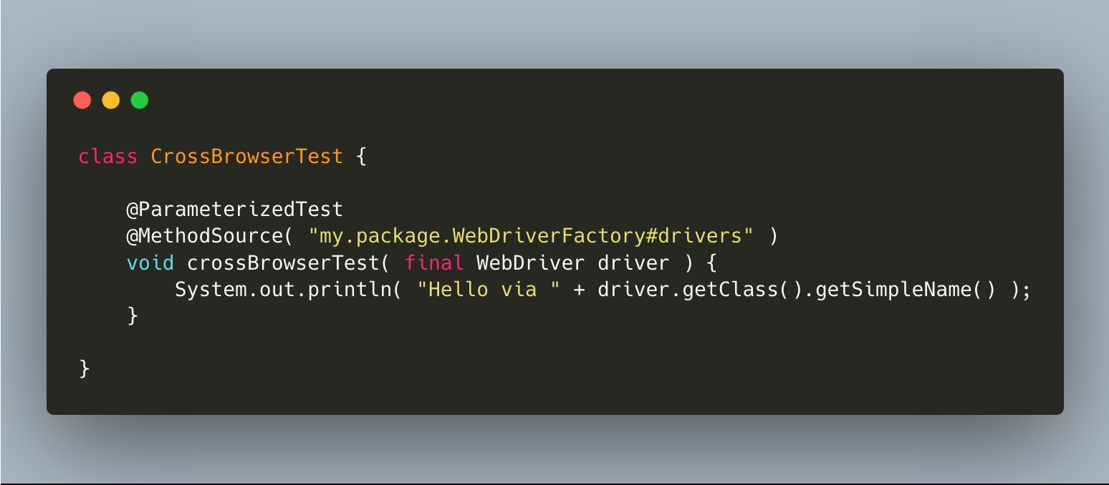
JUnit 5: @ParameterizedTest
Modern Testing mit JUnit 5

Slide 64
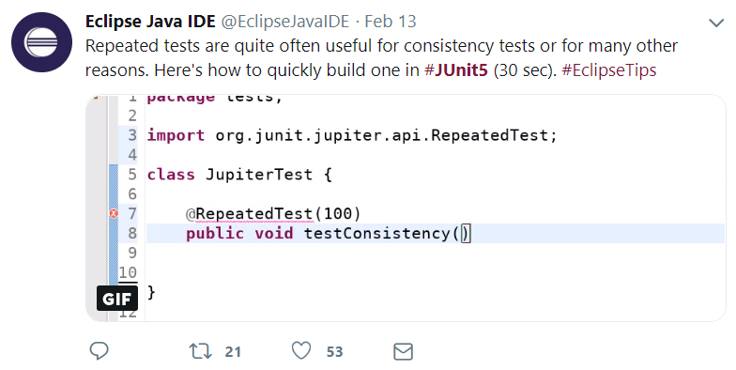
JUnit 5: @RepeatedTest
Modern Testing mit JUnit 5

Slide 65
JUnit 5: Best Practice
Modern Testing mit JUnit 5
Best Practice

Slide 66
JUnit 5: Best Practice
Modern Testing mit JUnit 5
Choosing the right assertion-type

Slide 67
JUnit 5: Choosing the right assertion-type
Modern Testing mit JUnit 5
/** * Don't check for nulls with {@link Assertions#assertTrue}. * Error messages will be meaningless and therefore useless. * Do use {@link Assertions#assertNotNull} or {@link Assertions#assertNull} instead. */ @Test void assertTrueNotNullTest() { // Unclear, useless error-message when tests fail assertTrue(dummyFruits.get(4) != null); // org.opentest4j.AssertionFailedError // It couldn't be more useless... }
/** * Don't check for nulls with {@link Assertions#assertTrue}.
* Error messages will be meaningless and therefore useless. * Use Assertions#assertNotNull} or Assertions#assertNull instead. */ @Test void assertTrueNotNullTest() { // Unclear, useless error-message when tests fail
assertTrue(dummyFruits.get(4) != null));
// org.opentest4j.AssertionFailedError // It couldn't be more useless... }

Slide 68
JUnit 5: Choosing the right assertion-type
Modern Testing mit JUnit 5
@Test void assertNotNullTest() { // Better error-message you can actually use and understand assertNotNull(dummyFruits.get(4)); // org.opentest4j.AssertionFailedError: expected: not <null> }

Slide 69
JUnit 5: Choosing the right assertion-type
Modern Testing mit JUnit 5
/** * The same applies for using {@link Assertions#assertTrue} and {@link Object#equals}. * Use {@link Assertions#assertEquals} instead. */ @Test void assertTrueEqualsTest() { // Unclear, useless error-message when tests fail assertTrue(TYPE.BANANA.equals(dummyFruits.get(2).getType()))); // org.opentest4j.AssertionFailedError: // It - again - couldn't be more useless... }
@Test void assertTrueEqualsTest() { // Unclear, useless error-message when tests fail assertTrue(TYPE.BANANA.equals(dummyFruits.get(2).getType())); // org.opentest4j.AssertionFailedError:
// It - again - couldn't be more useless... }

Slide 70
JUnit 5: Choosing the right assertion-type
Modern Testing mit JUnit 5
@Test void assertEqualsTest() { // Really useful error-message you can actually use and understand assertEquals(TYPE.BANANA, dummyFruits.get(2).getType())); // org.opentest4j.AssertionFailedError: expected: <BANANA> but was: <APPLE> }

Slide 71
JUnit 5: Best Practice
Modern Testing mit JUnit 5
Working with Delta

Slide 72
JUnit 5: Working with Delta
Modern Testing mit JUnit 5
@Test void wrongDelta() { // --> That's why the delta is important assertNotEquals(0.9, DummyUtil.calculateTimesThree(0.3)); // Using a 0.0 delta doesn't make much sense and JUnit 5 actively prevents it assertEquals(20.9, DummyUtil.calculateTimesThree(19), 0.0)); // org.opentest4j.AssertionFailedError: positive delta expected but was: <0.0> // With such a high delta the correctness of the calculation is no longer assured assertEquals(15.5, DummyUtil.calculateTimesThree(5.0), 0.5); }

Slide 73
JUnit 5: Working with Delta
Modern Testing mit JUnit 5
/** * You should use a very small delta, since the variations caused * by using doubles are mostly as small as e.g. 0.0000000000004. */ @Test void betterDelta() { assertEquals(15.0, DummyUtil.calculateTimesThree(5.0), 0.0000000001); }

Slide 74
JUnit 5: Working with Delta
Modern Testing mit JUnit 5
/** * In JUnit 5 you no longer have to necessarily declare the delta. * Implementation: AssertionUtils#doublesAreEqual(double, double). */ @Test void idealDelta() { assertEquals(15.0, DummyUtil.calculateTimesThree(5.0)); }

Slide 75
JUnit 5: Best Practice
Modern Testing mit JUnit 5
Parameter Reihenfolge

Slide 76
JUnit 5: Parameter-Reihenfolge
Modern Testing mit JUnit 5
@Test void wrongParameterOrder() { //Gives you unclear, actually wrong fail-reports! assertEquals(dummyFruits.get(2).getName(), "Grapefruit")); // . . . . . . ^expected . . . . . . . . . . . ^actual // org.opentest4j.AssertionFailedError: expected:
<Granny Smith Apple> but was: <Grapefruit> }
@Test void wrongParameterOrder() { //Gives you unclear, actually wrong fail-reports! assertEquals(dummyFruits.get(2).getName(), "Grapefruit")); // . . . . . . . ^expected . . . . . . . . . . ^actual // org.opentest4j.AssertionFailedError:
expected: <Granny Smith Apple> but was: <Grapefruit> }

Slide 77
JUnit 5: Sonstiges
Modern Testing mit JUnit 5
@ParallelExecution aktuell in Arbeit
@AssertTimeout
TestTemplates
Ideen
@DisabledUntil(Date.class)
Nie wieder deaktivierte Tests vergessen
Wenn Tests im großen Stil geschrieben werden für noch nicht entwickelte Komponenten

Slide 78



Dmitrij Drandarov
GitHub: https://github.com/dmitrij-drandarov
Twitter: https://twitter.com/drandarov_io
E-Mail: dmitrij.drandarov@outlook.com
Inhalt und Folien unter:
http://junit5.dmitrij-drandarov.com

